Slide 1

Google Cyclistic DA Capstone
By Kenny
21st Jan 2023

Slide 2
Sceneario
You are a junior data analyst working in the marketing analyst team at Cyclistic, a bike-share company in Chicago.
You are to design a new marketing strategy to convert casual riders into annual members.

Slide 3

Steps taken
Business Task
Cleaning Data
Conducting Descriptive Analysis
Data Visualization
Analysis Summary
Recommendation

Slide 4
Business Objective
To find out how annual and causal riders use Cyclistic bikes differently and from your findings, design a new marketing strategy to convert casual riders into annual members.

Slide 5

Cleaning Data Phase 1
There are many ways to clean data, but for this case, we will be using Rstudio due to its convenience.
Packages needed:
Tidyverse (versatile package with a lot of functions)
Lubridate (to work with the date functions more efficiently)
Ggplot2 (for all our data modeling/visualization needs)

Slide 6


Cleaning Data Phase 1
Reading Data
We will be using 2019 q2 – 2020 q1 data for this Capstone.
Upload the raw data to Rstudio:
Next compare column names of each file

Slide 7
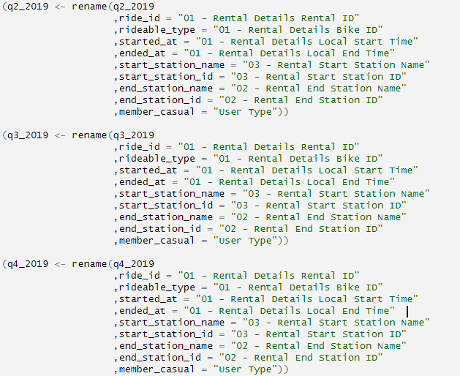
Cleaning Data Phase 1
Renaming Data
As the data columns in 2020 has a new naming convention, we need to rename the other files to join them into a single file later.

Slide 8

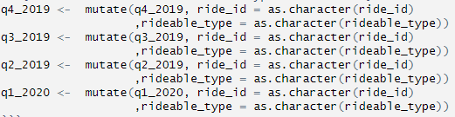
Cleaning Data Phase 1
Look for incongruencies
We have to ensure that our files are of the same data types so that they can stack correctly.
Convert ride_id and rideable_type to character so that they can stack correctly

Slide 9
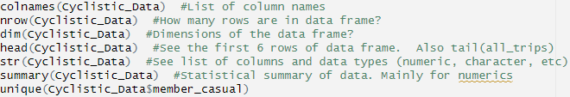
Cleaning Data Phase 1
Combining the files
Now we can combine the files together
Remove lat, long, birthyear, and gender fields as this data was dropped beginning in 2020
Inspect the new data table created

Slide 10
Cleaning Data Phase 2
Problems we have to address
In the "member_casual" column, there are two names for members ("member" and "Subscriber") and two names for casual riders ("Customer" and "casual"). We will need to consolidate that from four to two labels.
The data can only be aggregated at the ride-level, which is too granular. We will want to add some additional columns of data -- such as day, month, year -- that provide additional opportunities to aggregate the data.
We will want to add a calculated field for length of ride since the 2020Q1 data did not have the "tripduration" column. We will add "ride_length" to the entire dataframe for consistency.
There are some rides where tripduration shows up as negative, including several hundred rides where Divvy took bikes out of circulation for Quality Control reasons. We will want to delete these rides.

Slide 11


Cleaning Data Phase 2
Problem #1
Before 2020, Divvy used different labels for these two types of riders, we want to make our dataframe consistent with their current nomenclature
Adding columns for date, month, year and day will allow us to aggregate ride data for each month, day, or year, before completing these operations we could only aggregate at the ride level
Problem #2

Slide 12
Cleaning Data Phase 2
Problem #3
Add a "ride_length" calculation to all_trips (in seconds)
The dataframe includes a few hundred entries when bikes were taken out of docks and checked for quality by Cyclistic or ride_length was negative. We will create a new version of the dataframe (v2) since data is being removed
Problem #4

Slide 13

Conducting Descriptive Analysis
Descriptive Analysis
There are 2 ways to conduct the descriptive analysis
Or we can condense these 4 lines using summary
Compare Casual and Annual members
Analyze ride data by type and weekday

Slide 14
Exporting out for further analysis
Export our cleaned data in .csv format for further analysis
While we can do our visualizations on R, the visualizations shown in the next few slides will be done on tableau, and they can be accessed via this link.

Slide 15
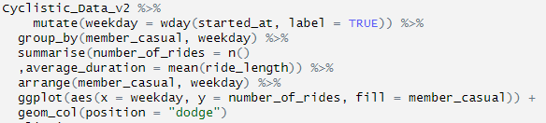
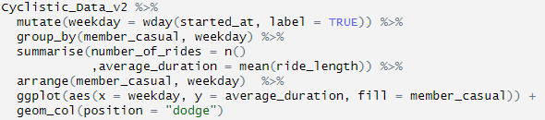
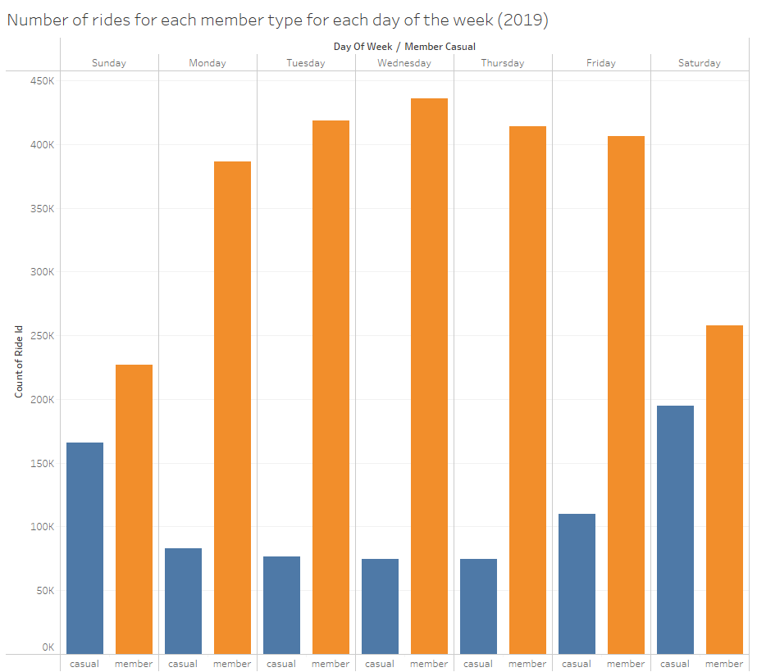
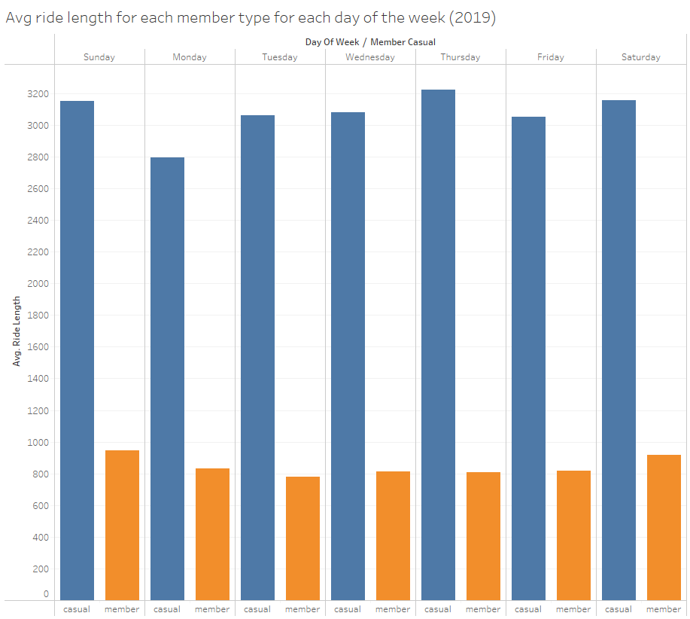
Visualization
Visualize number of rides by rider type and average duration
By rider type
By average duration

Slide 16
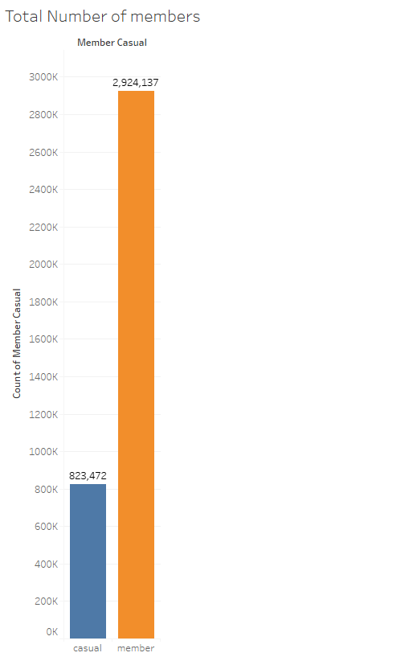
Analysis Summary
More annual members than casual members
2.9 million annual members as compared to 800k casual
More than 3 times annual members than casual

Slide 17
Analysis Summary
More rides for annual member each day
But on Fridays, Saturdays and Sundays we will see a spike in rides for casual members, and lesser rides for annual members on Saturdays and Sundays
This could be due to casual members going for leisure rides on the weekends, and the annual members resting and not working on Saturdays and Sundays

Slide 18
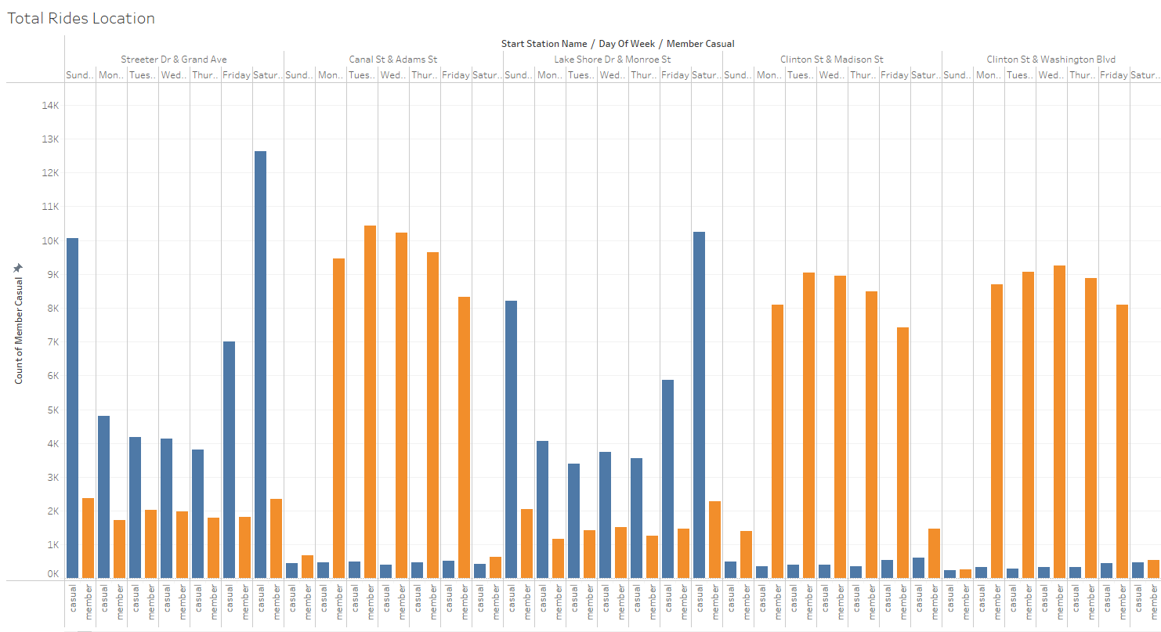
Analysis Summary
Casual Members for leisure, Annual for work
If we were to look at the end location of the bicycles, we notice that most of the casual members end their rides in recreational places whereas the annual members will end tend to end their rides in business districts.

Slide 19
Analysis Summary
Longer rides for casual member each day
Casual riders tend to ride for longer duration as compared to annual members
This could be related to the previous point we made; about how casual members ride for leisure as compared to annual members who ride for commuting to work

Slide 20
Recommendations
Annual and Casual members generally ride for different purposes
Rather than looking to convert the casual members to annual members, we can introduce another package to target members who ride for leisure
Perhaps, a campaign where annual members who clock X amount of mileage per ride will be eligible for a token or reward, this might help encourage the casual riders who ride far distance for leisure to convert to annual membership.
However, we also need to consider how often these casual riders ride their bikes, and we are unable to tell from the data provided; more data is needed, and it is recommended that we launch a survey to look out for both the casual and annual member needs before considering our next steps.

